Slide 1
Document Classifier v1.0
(Read behind the lines)
Nibi Maouriyan

Slide 2
Problem Statement
Create a Document Classification model using Machine Learning / Deep Learning
Format :
We will provide a dataset that contains five different kinds of documents.
It is expected to train a classifier using the given dataset.
Output :
Given a document in .txt file. It should classify the category of the document.

Slide 3
Why did I choose ?
Use cases :
Legal Documents Classification
Medical Record Classification
Document Summarisation
How did I approach ?
User/Client must be able to classify documents at ease which can be further summarised.

Slide 4
Process
Use the Model in Flask web app
Train a CNN model
iPreprocess the data
Importing the model and making a prediction as result
Converting txt files into a single CSV file
Use of Vectorization with the Help of Glove(vector representation od words)

Slide 5
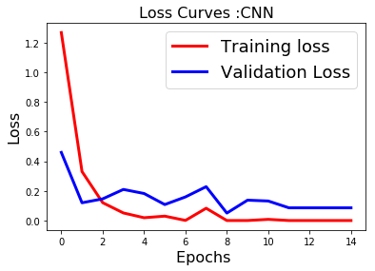
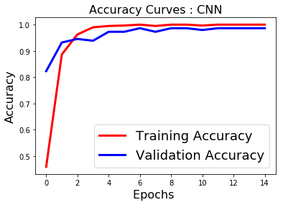

Slide 6
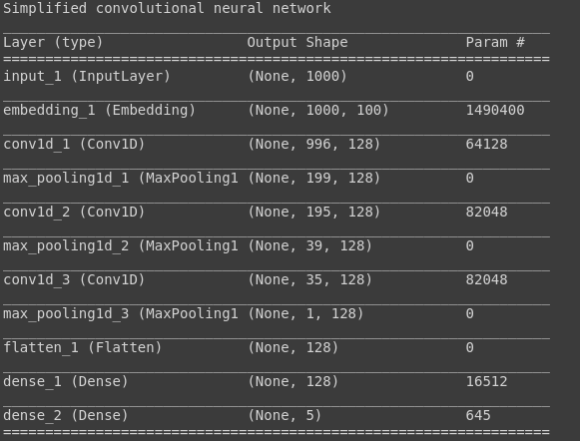

Slide 7
Problems Faced
Unable to save the model in required format.
Loading the model in Web App.
Transforming input to Vectors.
Varying number of features in input.

Slide 8
Solutions
Converted keras model to Pickle model.
Loaded the Pickle model in web app.
Also saved the vector model as pickle.
Vectorised the input before loading into model.

Slide 9
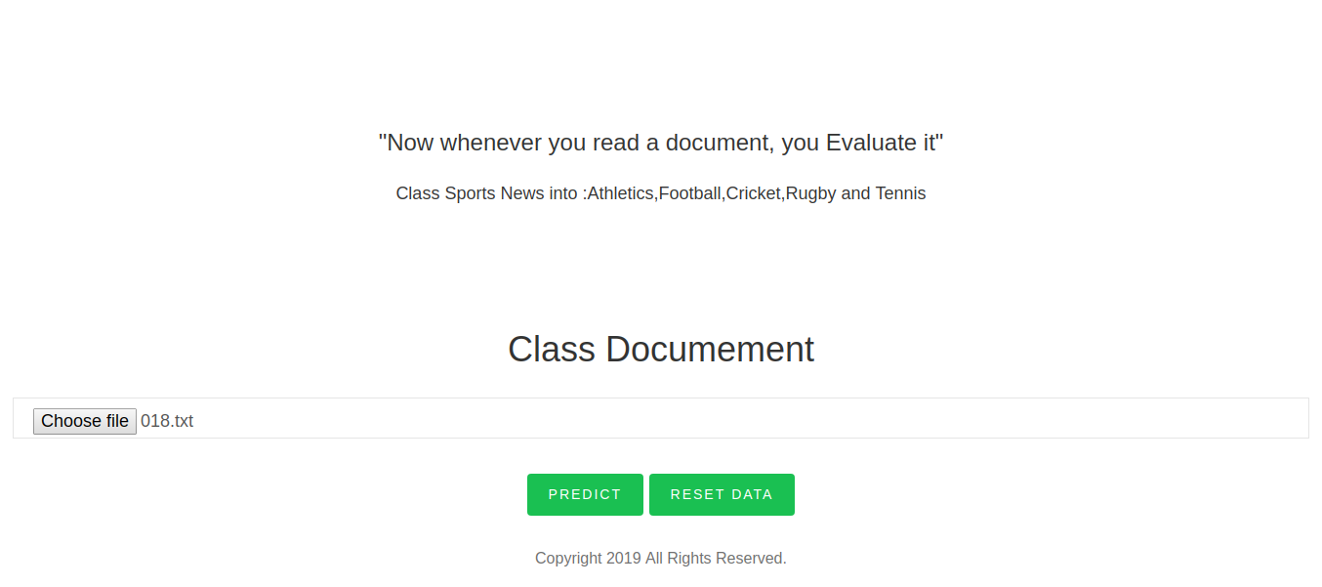

Slide 10
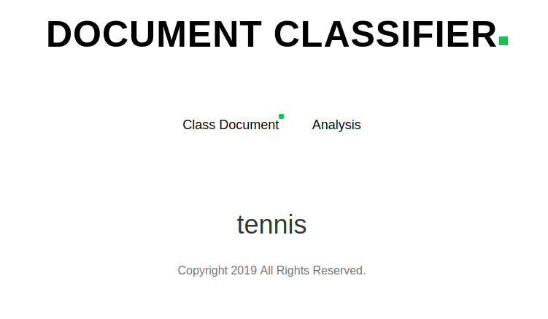

Slide 11
Further Works

